Slide 1

Game Development Brief

Slide 2
Timeline of Prototypes
Engineer's Workshop Prototype by July 6th
Science Explorer Prototype by July 13th
Space Explorer Prototype by July 20th
Nature Tracker Prototype by July 27th
Tech Coder Prototype by July 27th

Slide 3
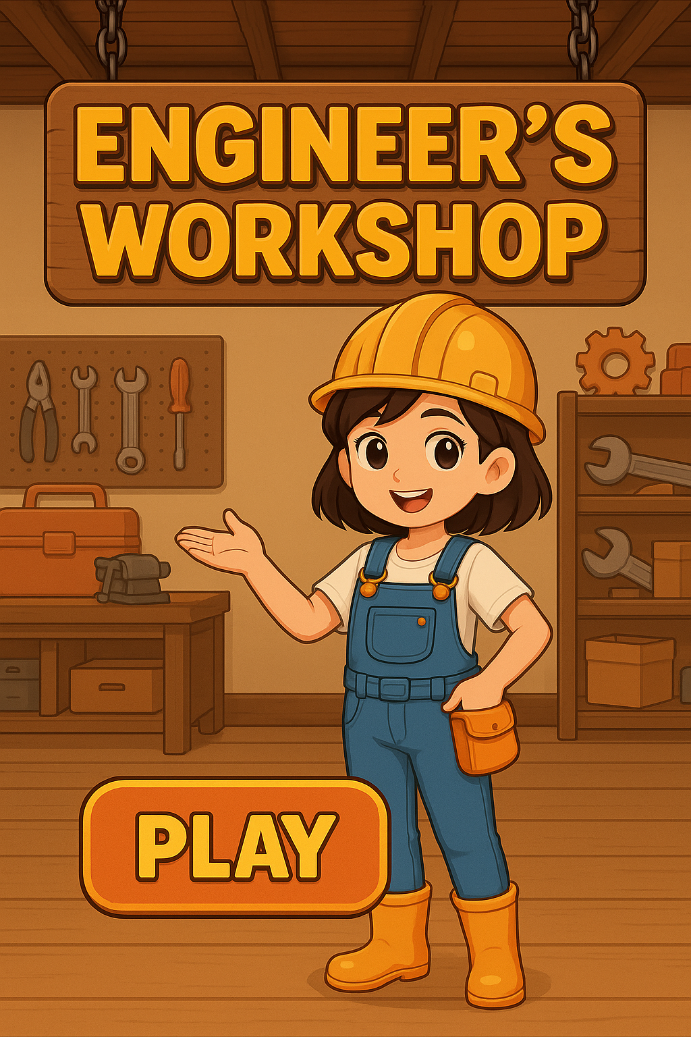
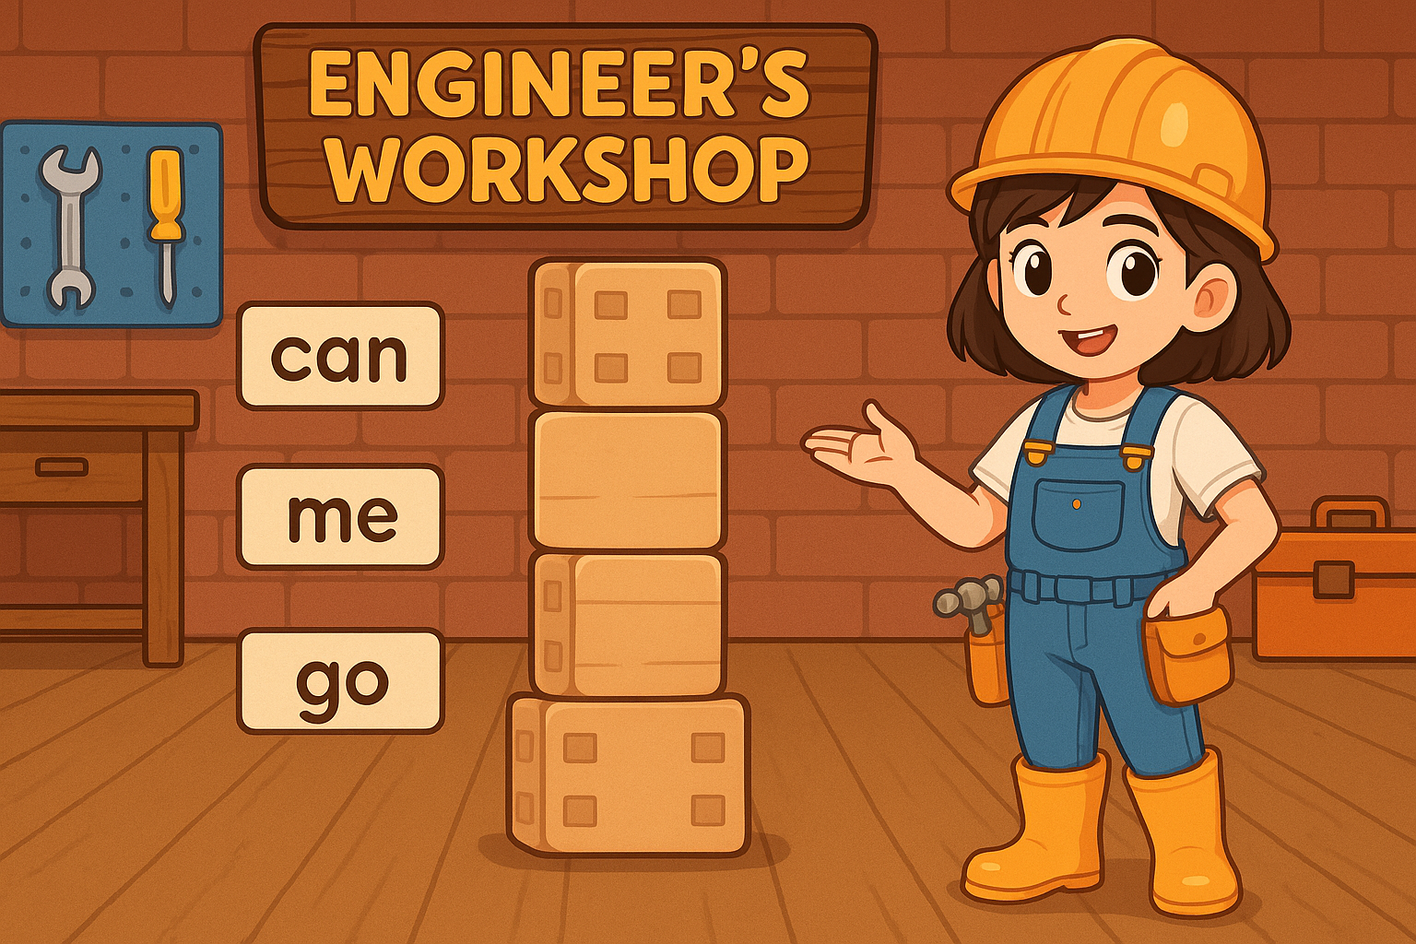
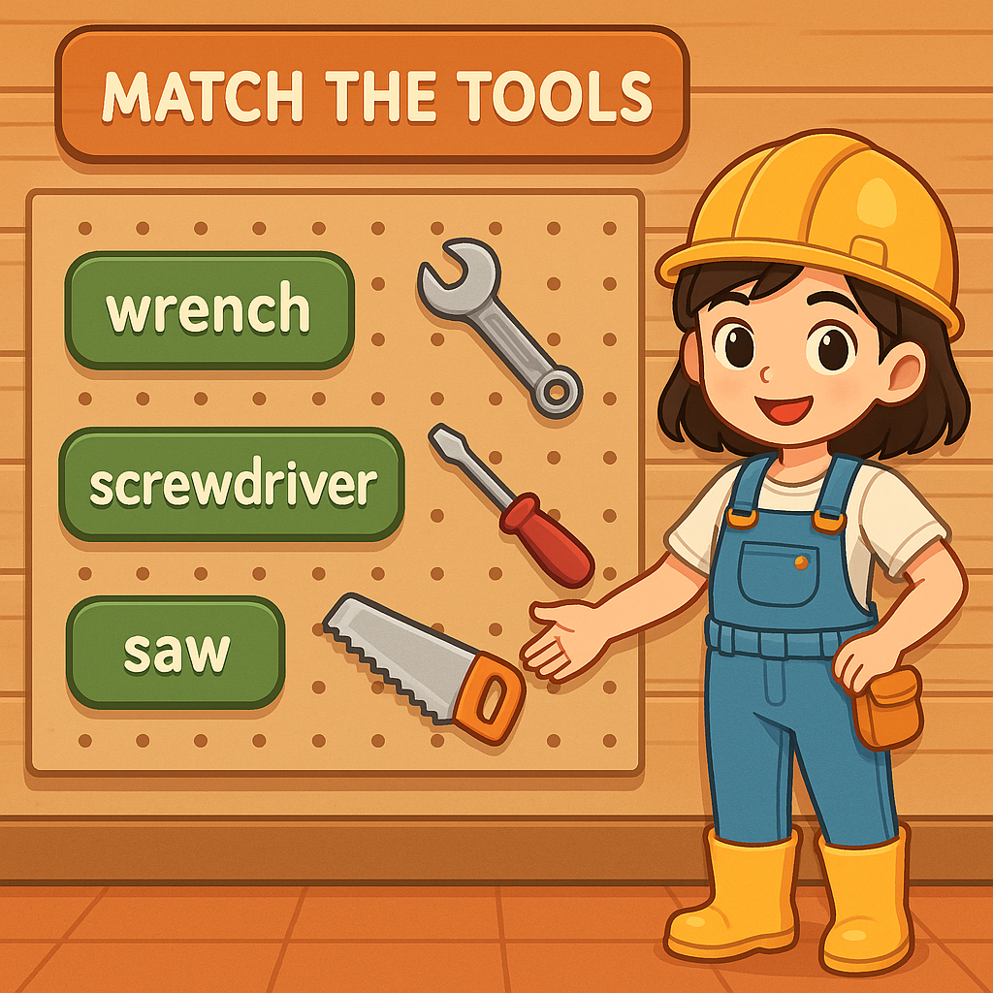
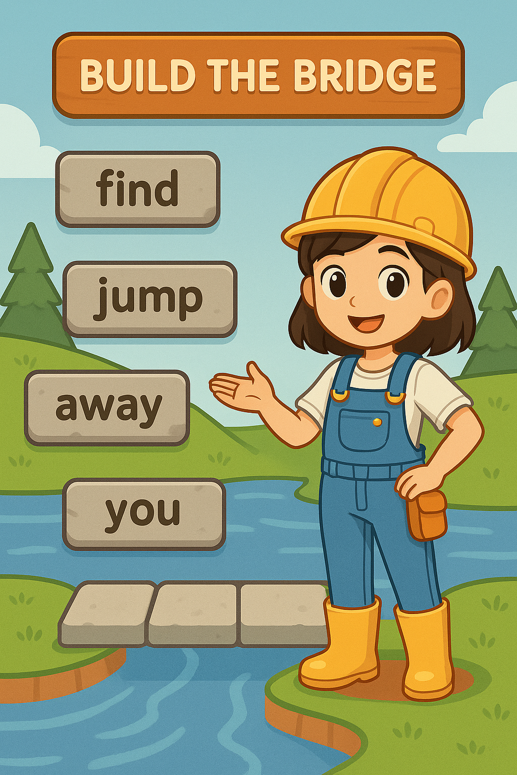
Engineer’s Workshop
MAIN MENU
BUILDING TOWER
TOOLS TO NAMES
BUILD A BRIDGE

Slide 4
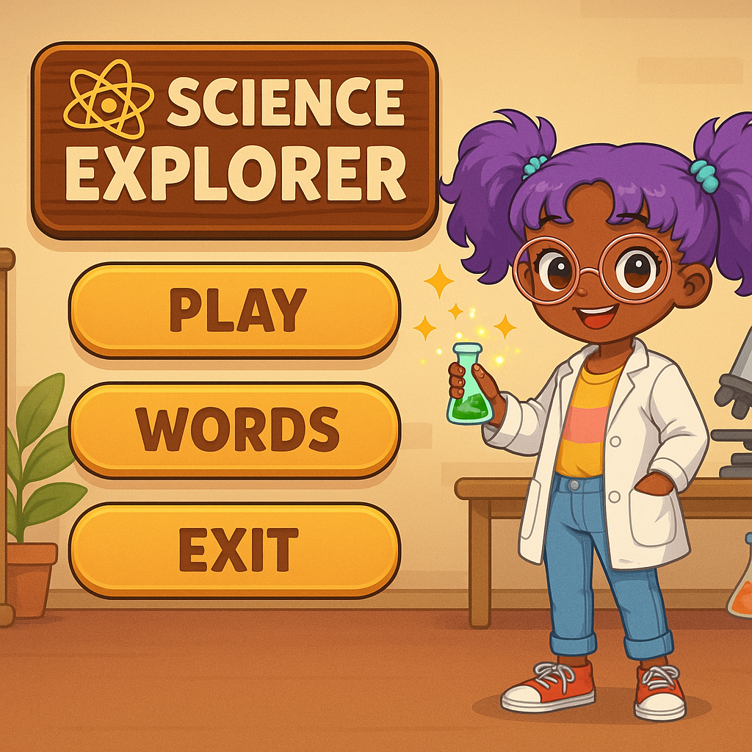
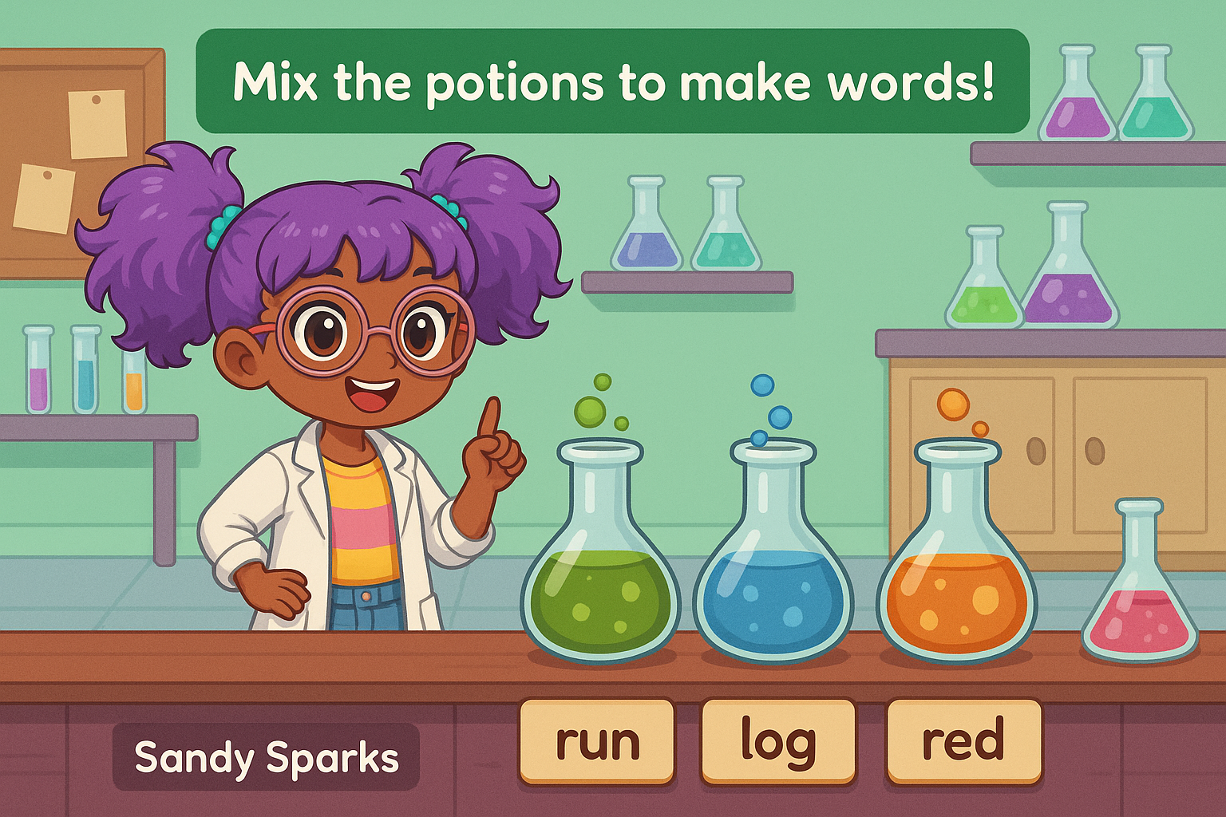
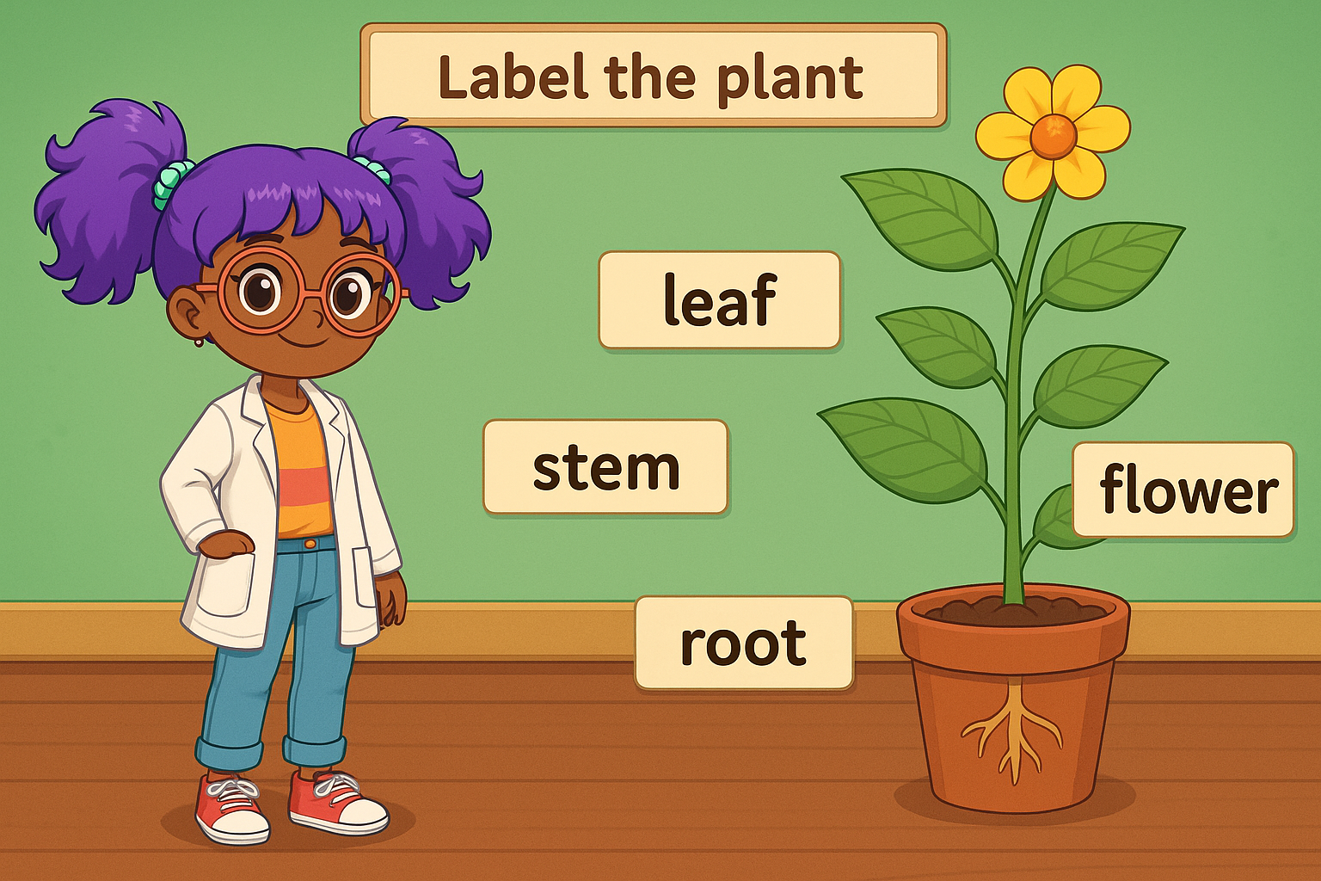
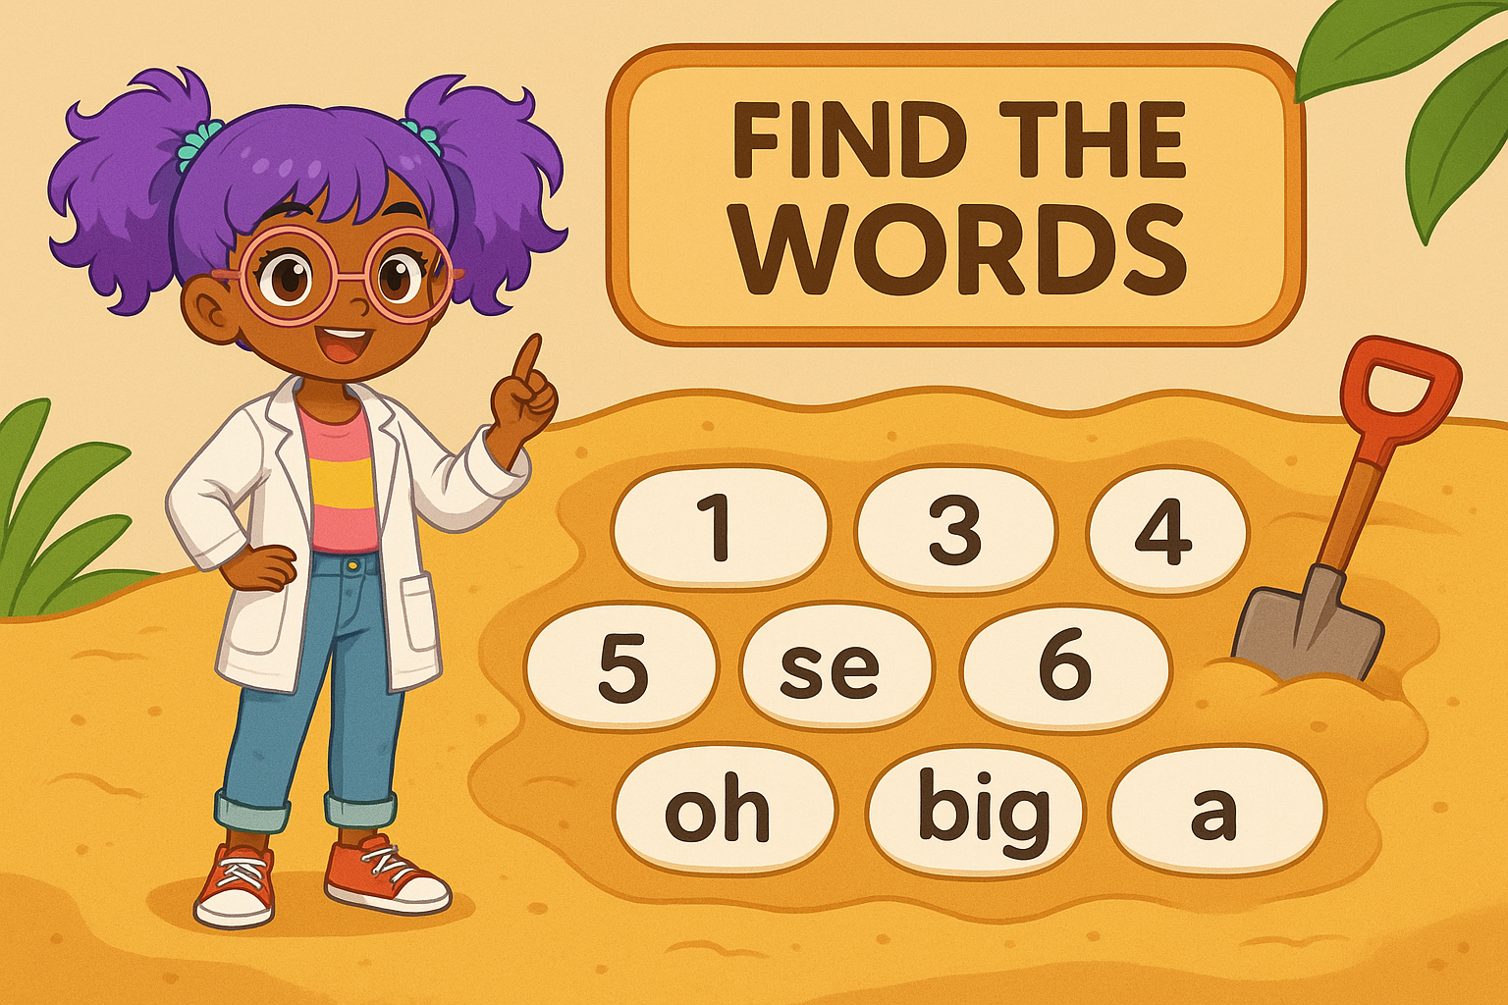
Science Explorer
MAIN MENU
MAKING WORDS
LABELLING PLANTS
FINDING WORDS

Slide 5
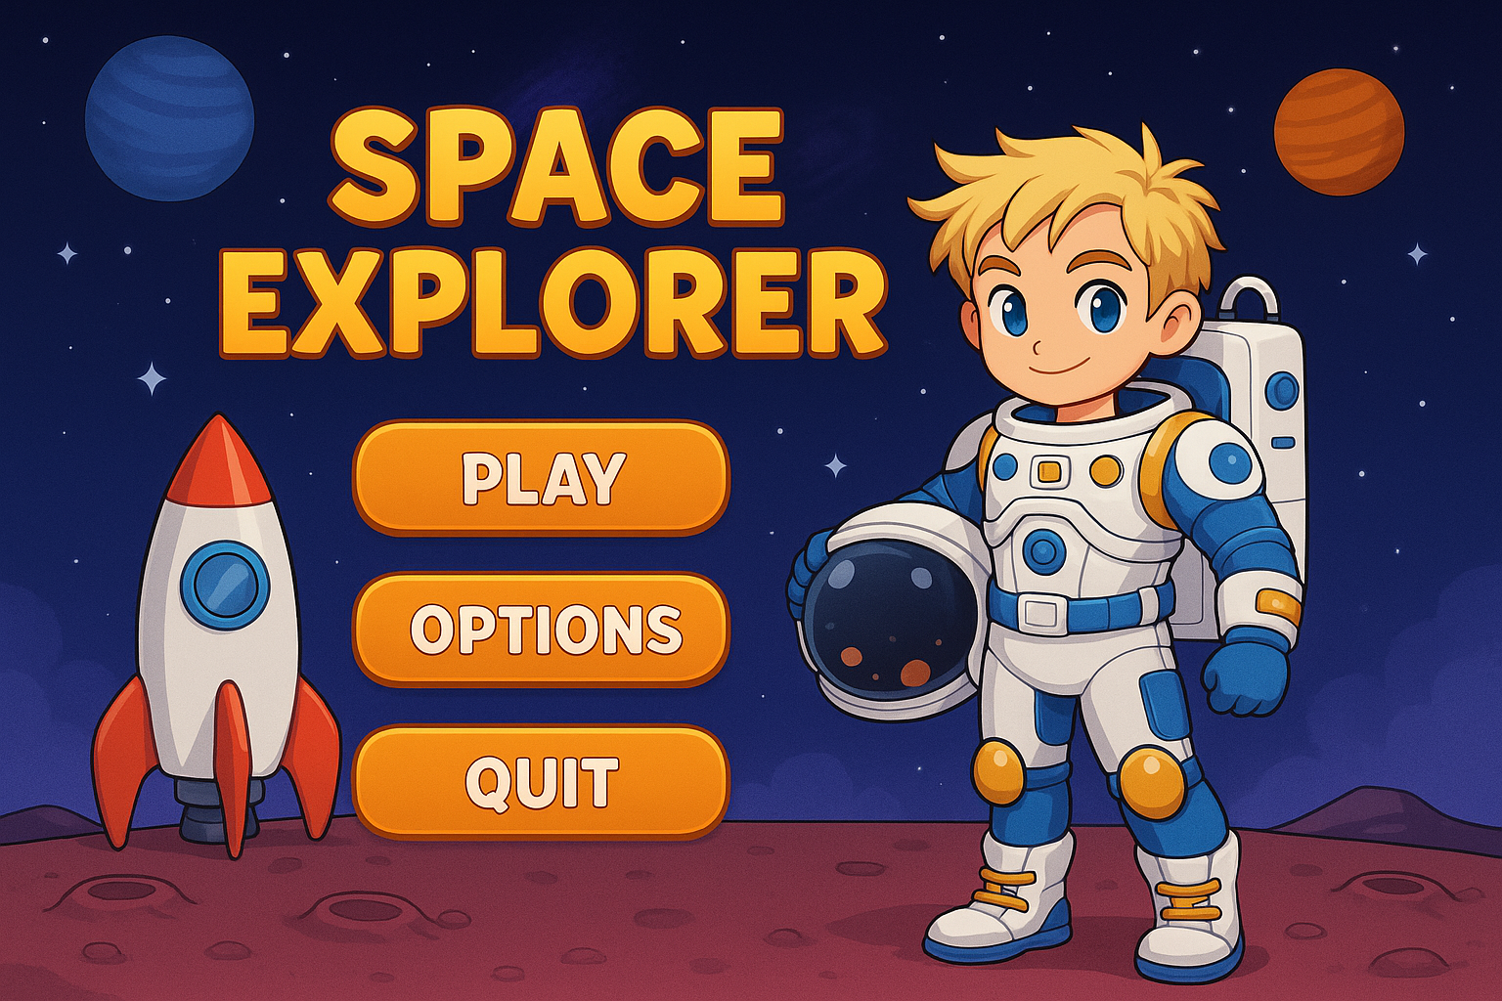
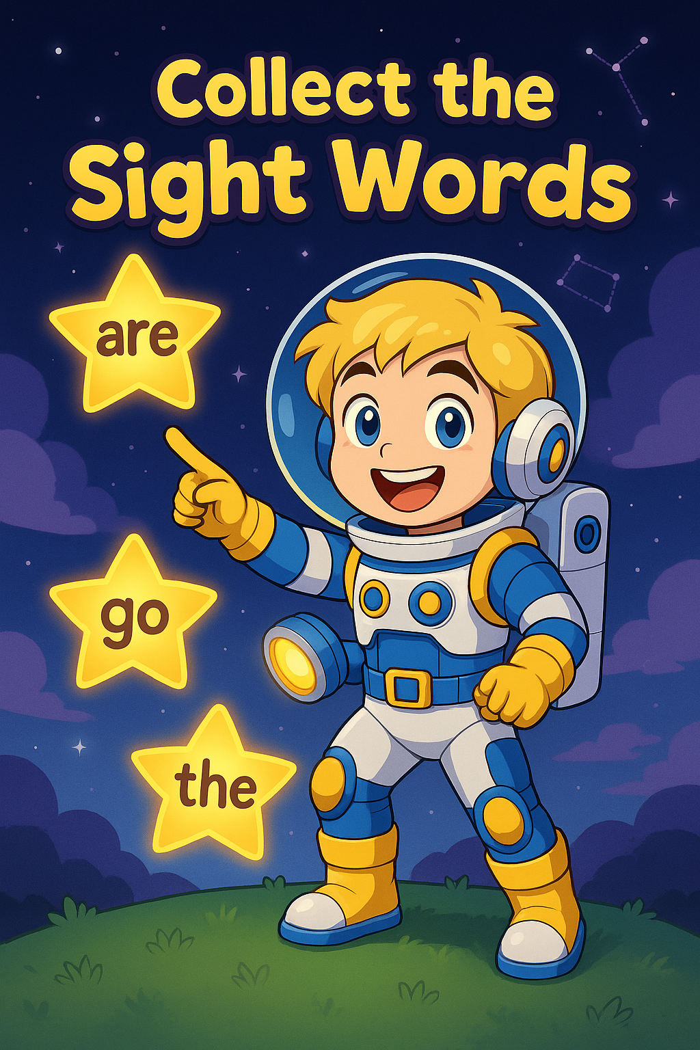
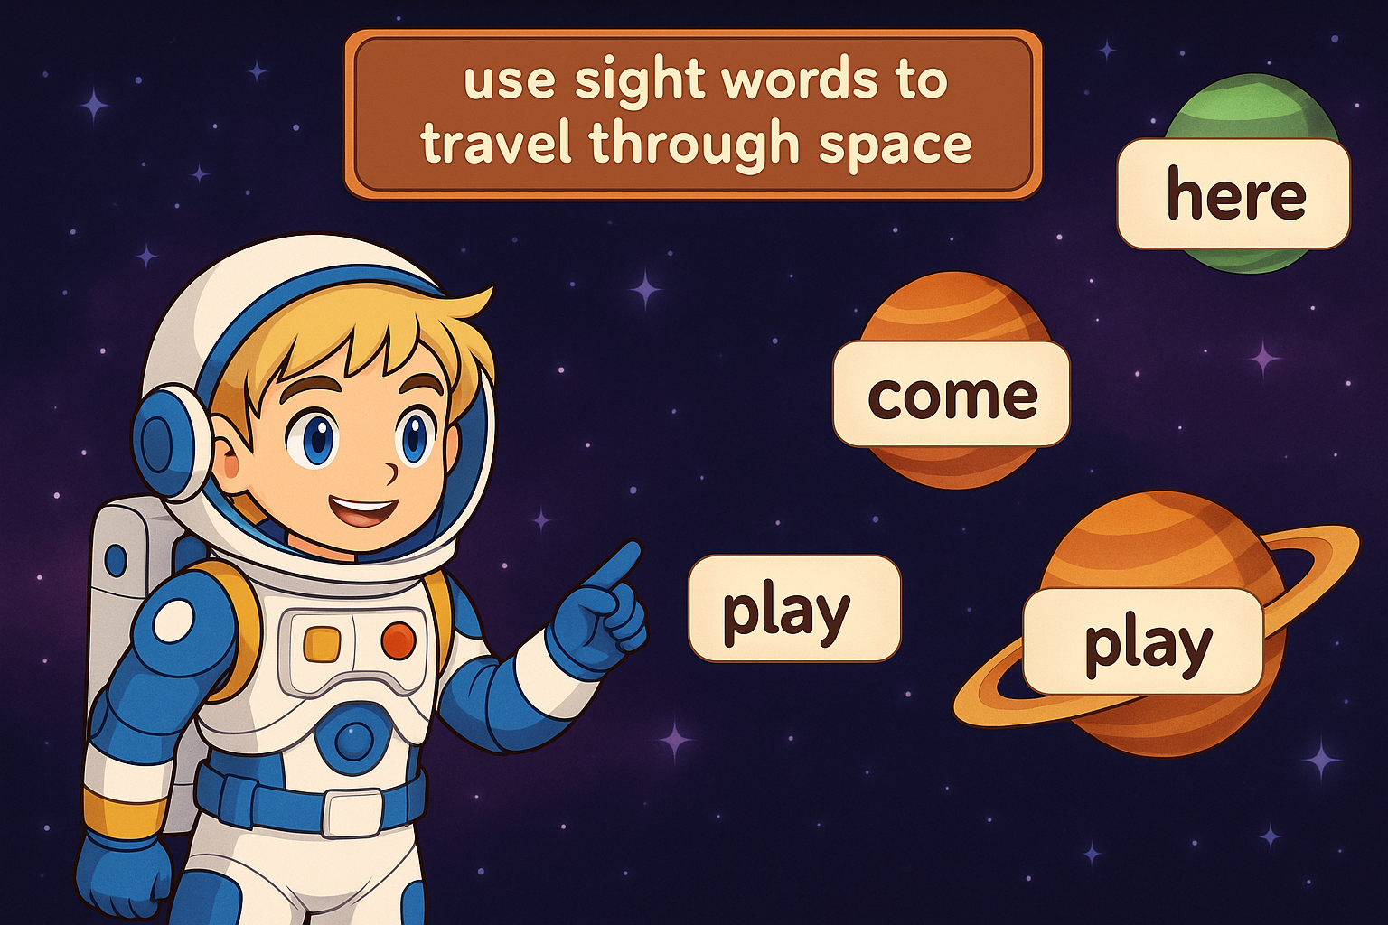
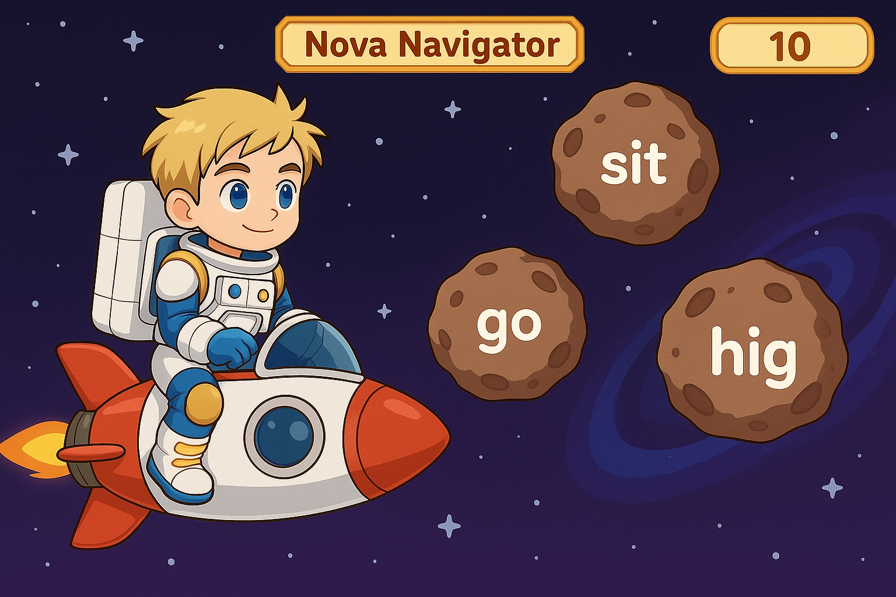
Space Explorer
MAIN MENU
COLLECT WORDS
SPACE TRAVEL
DESTROY WRONG WORDS

Slide 6
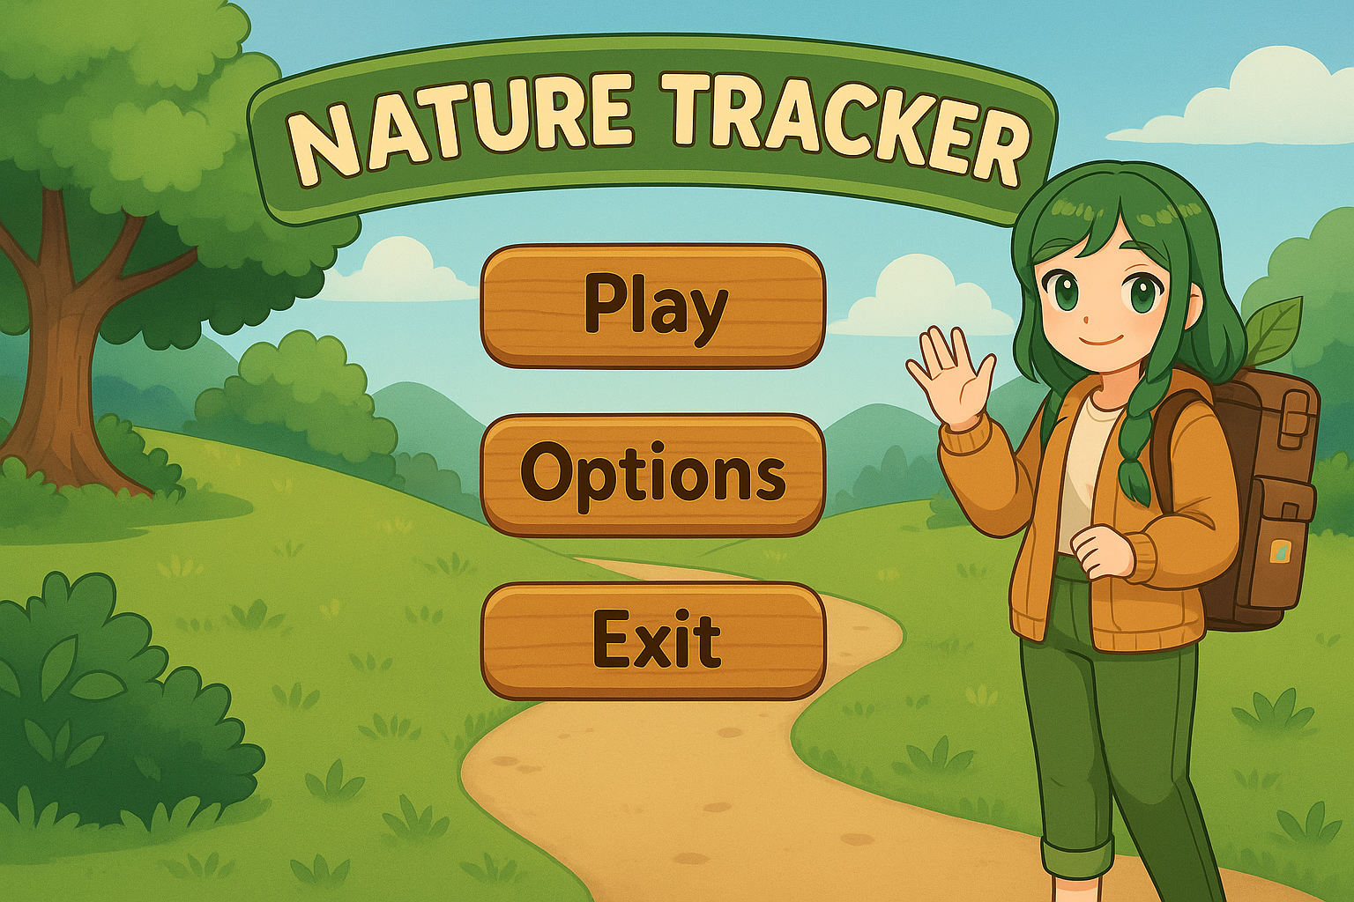
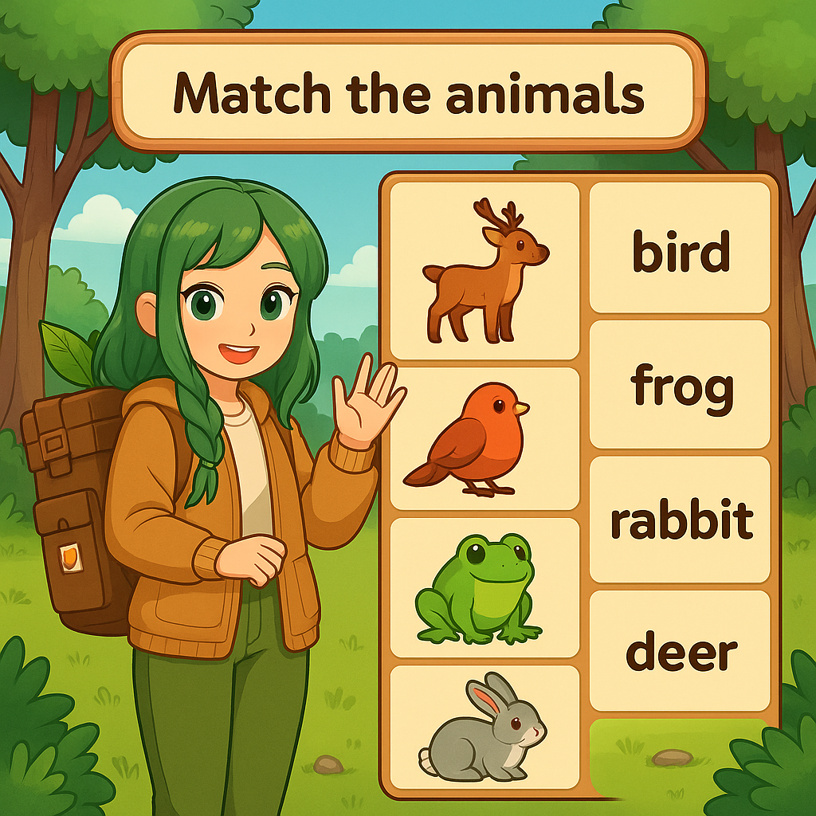
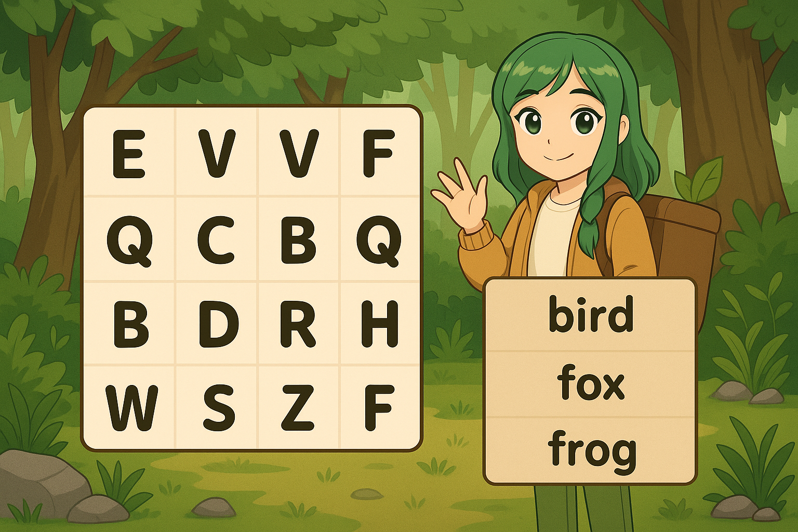
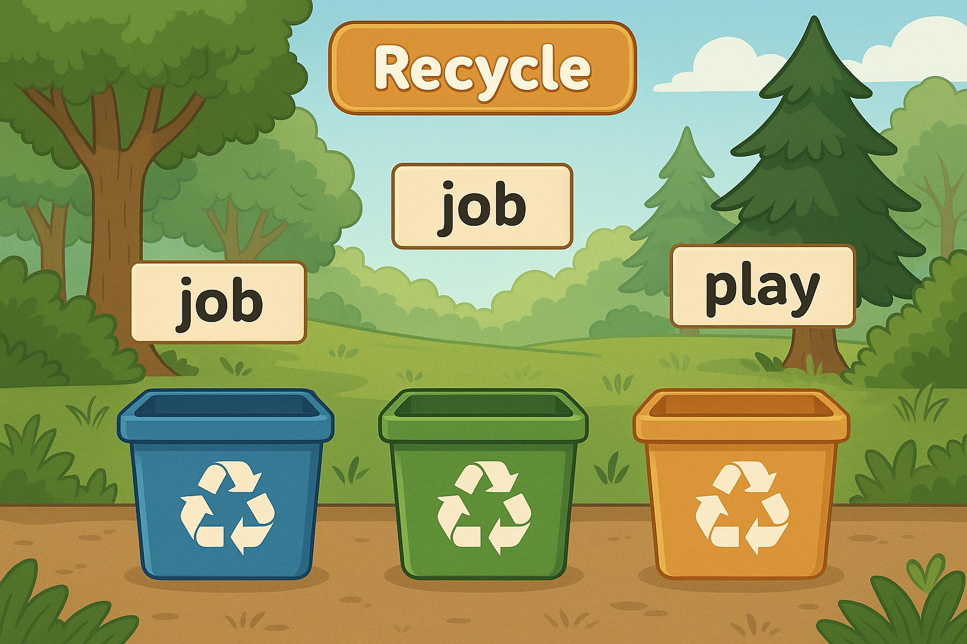
Nature Tracker
MAIN MENU
ANIMAL MATCH
WORD SEARCH
WORD SORT

Slide 7
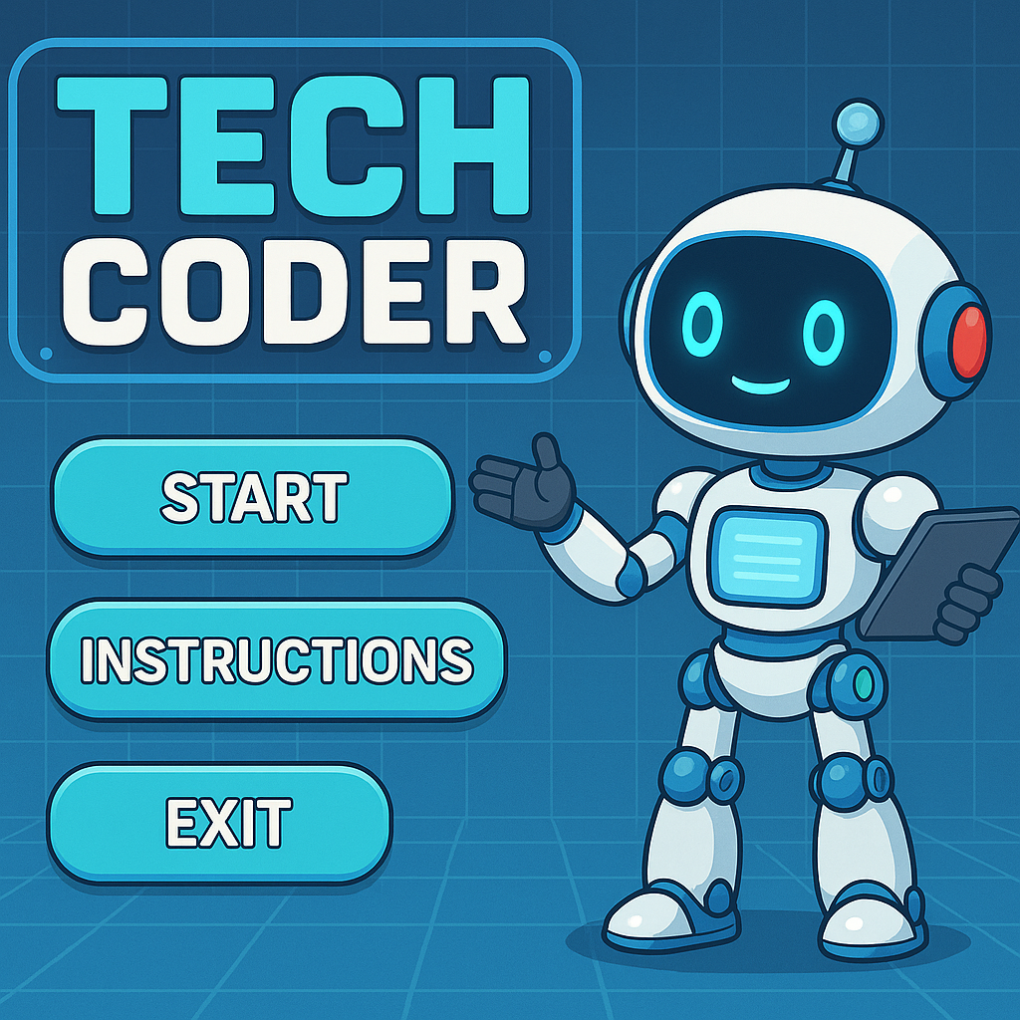
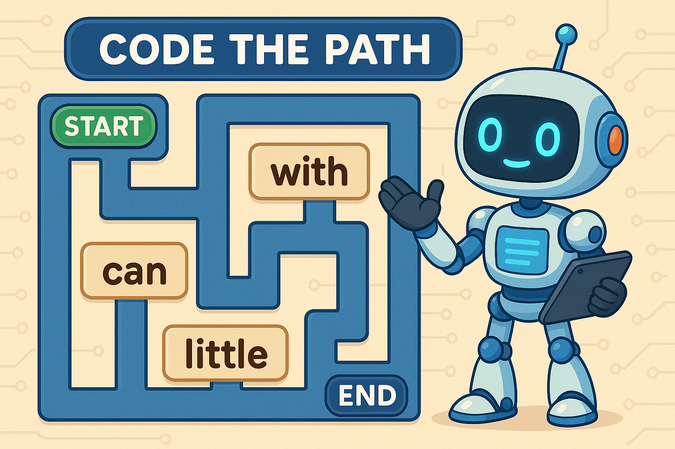
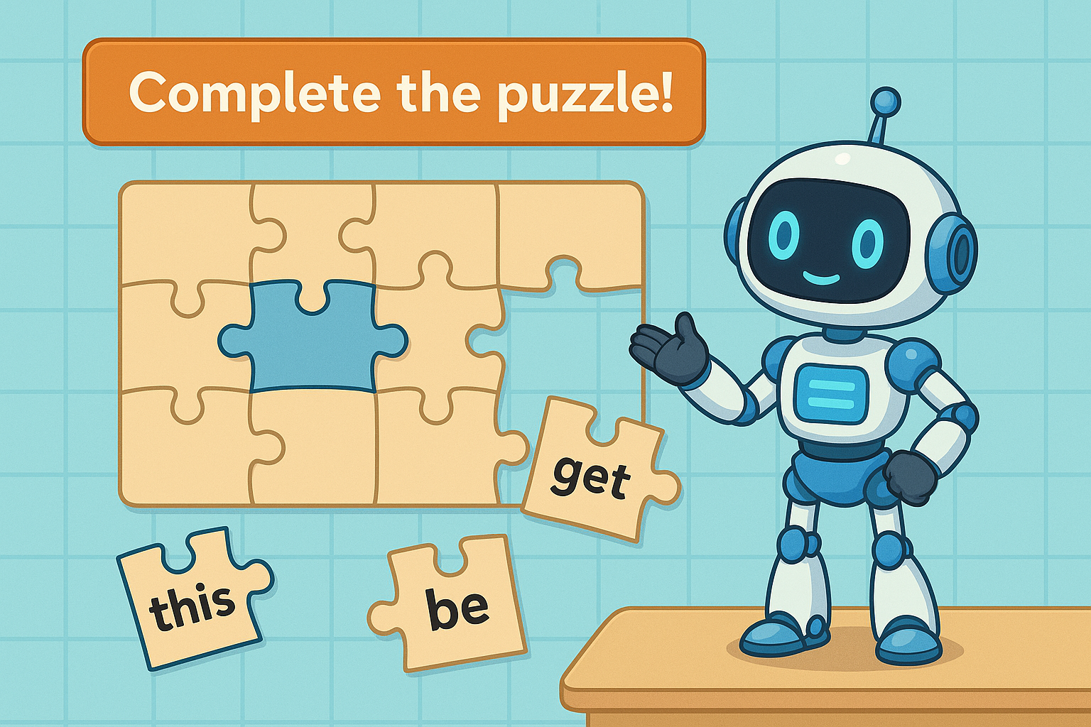
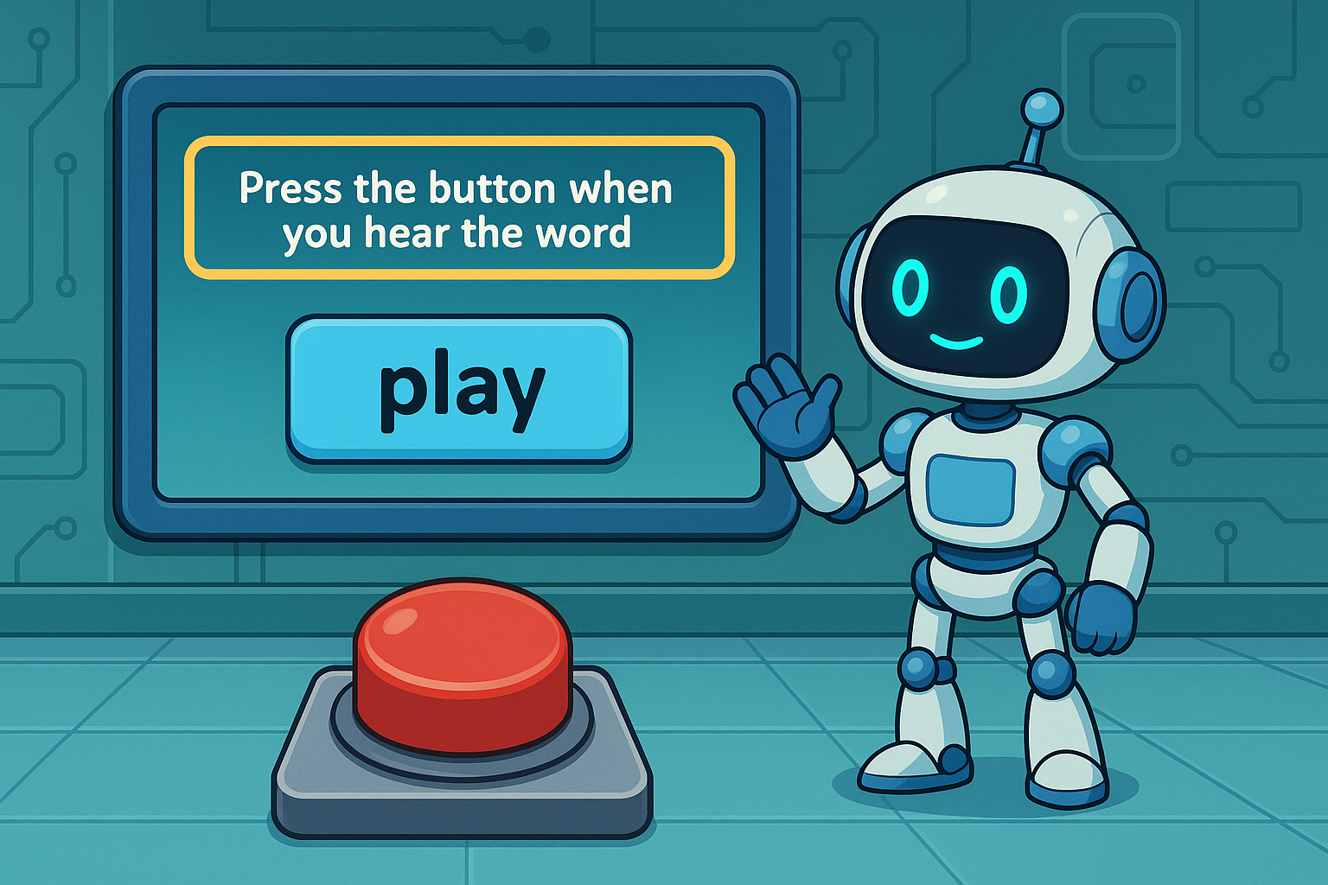
Tech Coder
MAIN MENU
MAZE
PUZZLE
AUDIO CUE

Slide 8
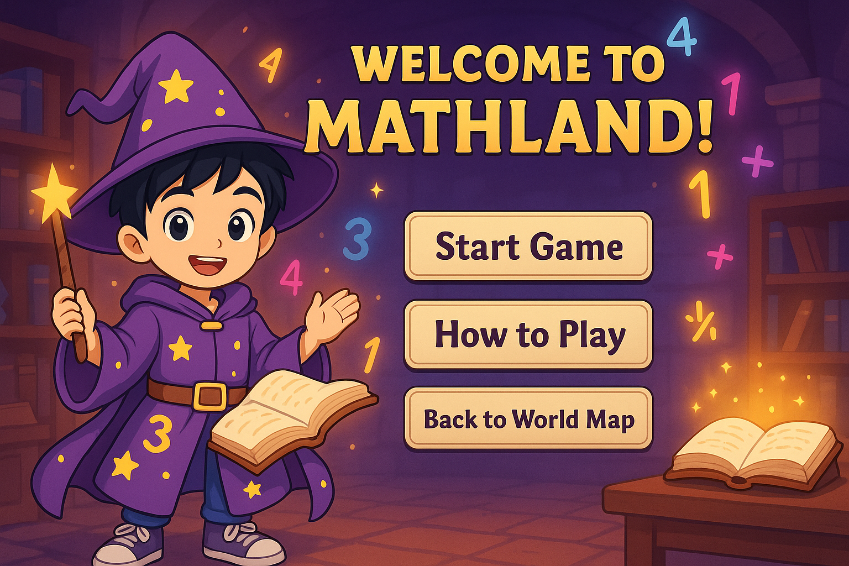
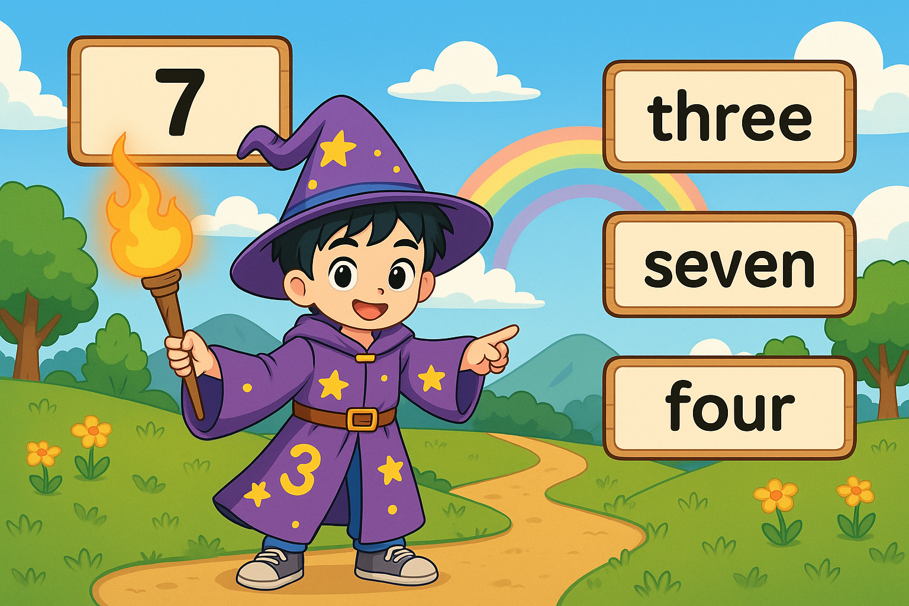
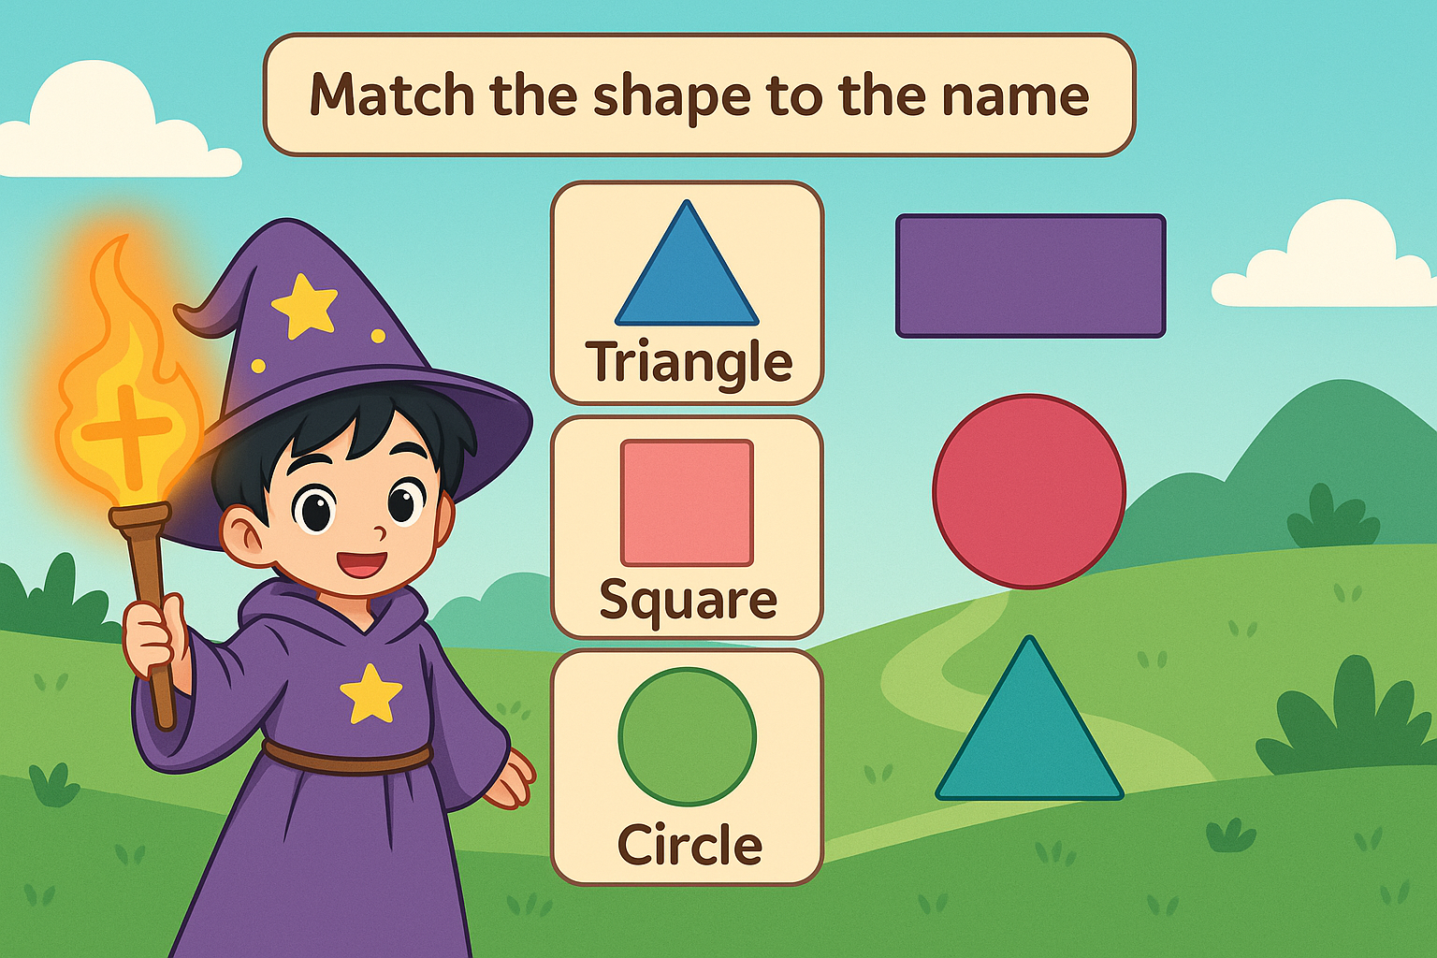
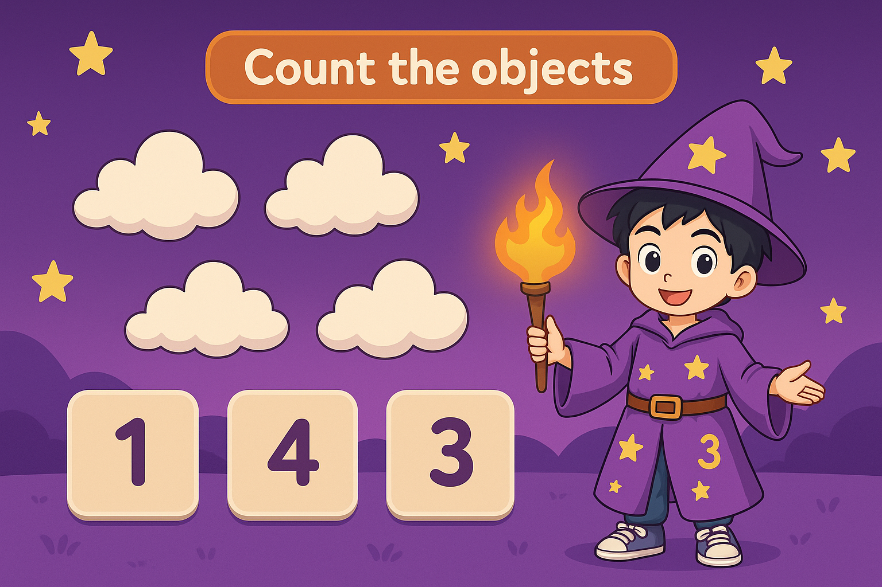
FUTURE OF MATHLAND
MAIN MENU
NUMBERS TO NAMES
SHAPE MATCHING
COUNTING

